Slide 2
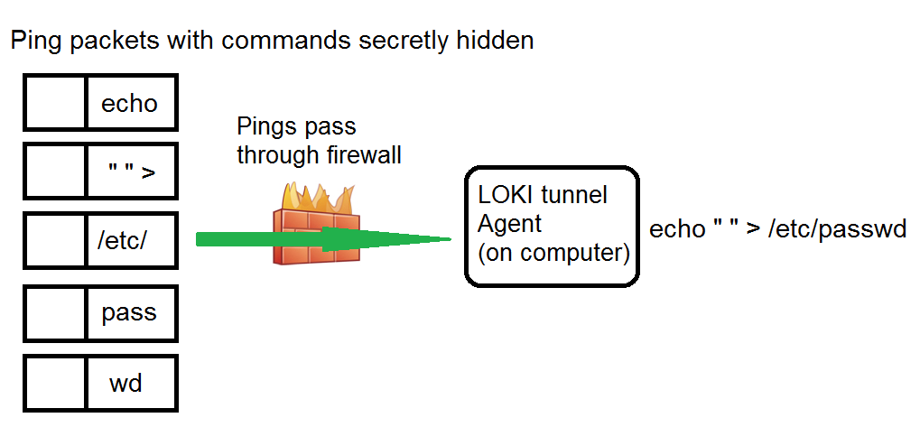
LOKI
Pings easily go through the firewalls undetected!

Slide 3
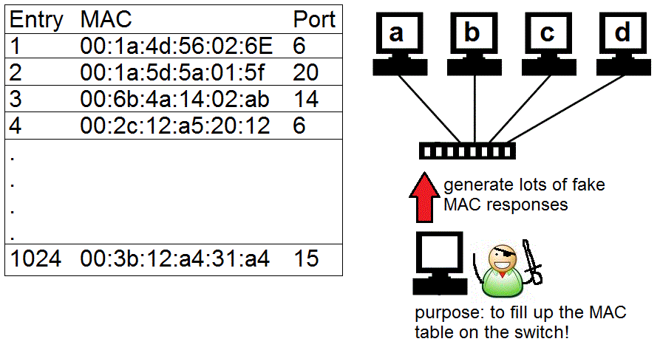
MAC flooding

Slide 4
Buffer Overflows (chapter 11)
What are they? What are the attributes of a buffer overflow?
NOTE SERIOUS LIBERTIES have been taken with the example slides of a buffer overflow to simplify the attack so it’s easier to understand. In reality it’s more complicated than shown

Slide 5
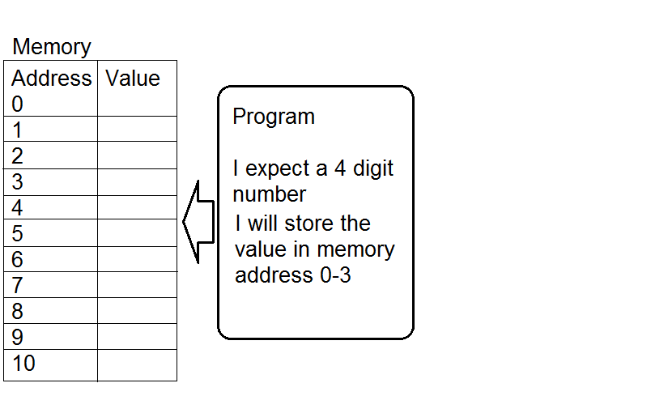
Buffer Overflow

Slide 6
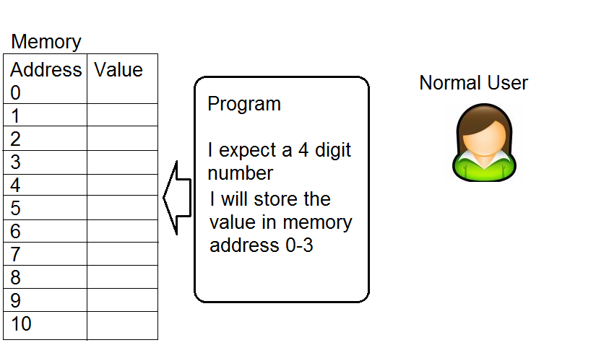
Buffer Overflow

Slide 7
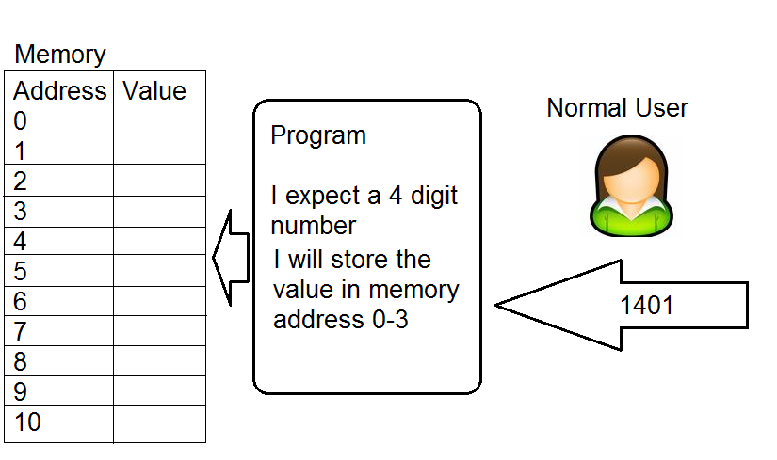
Buffer Overflow

Slide 8
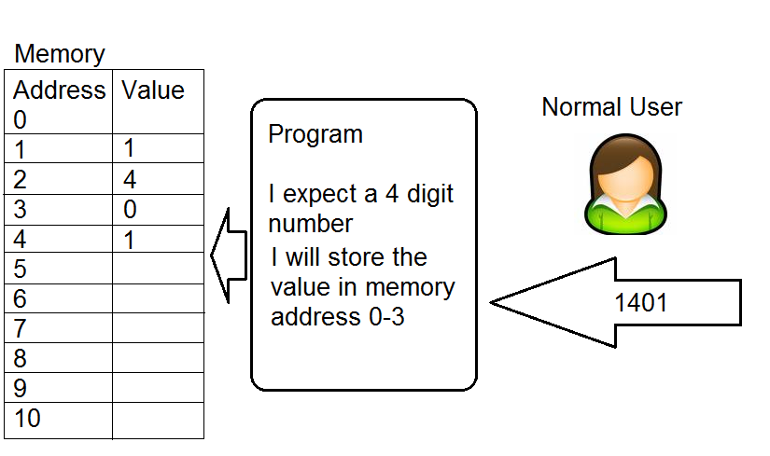
Buffer Overflow

Slide 9
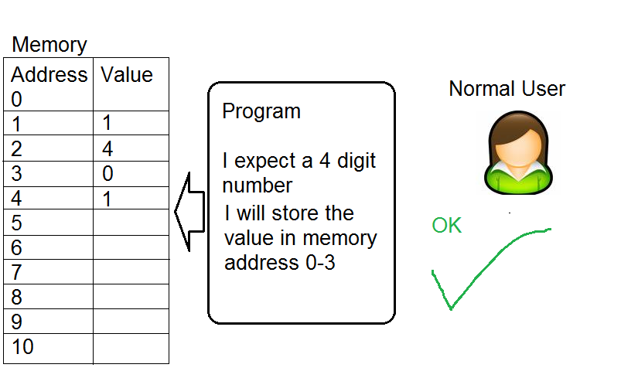
Buffer Overflow

Slide 10
Buffer Overflow

Slide 11
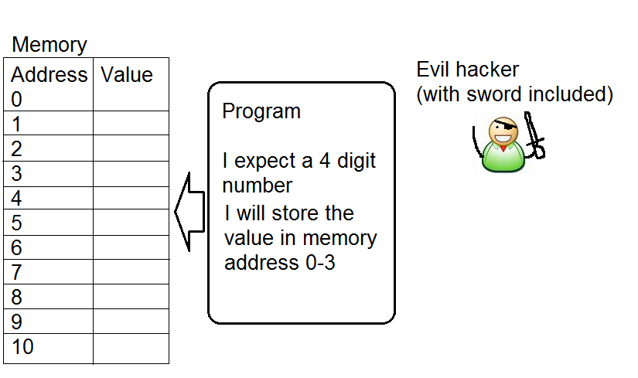
Buffer Overflow

Slide 12
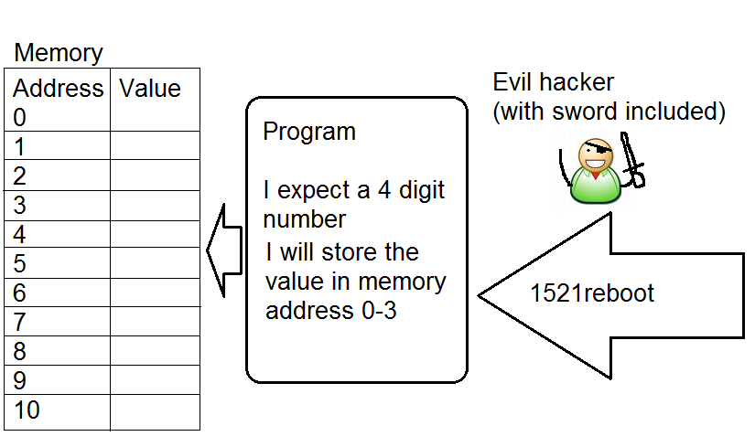
Buffer Overflow

Slide 13
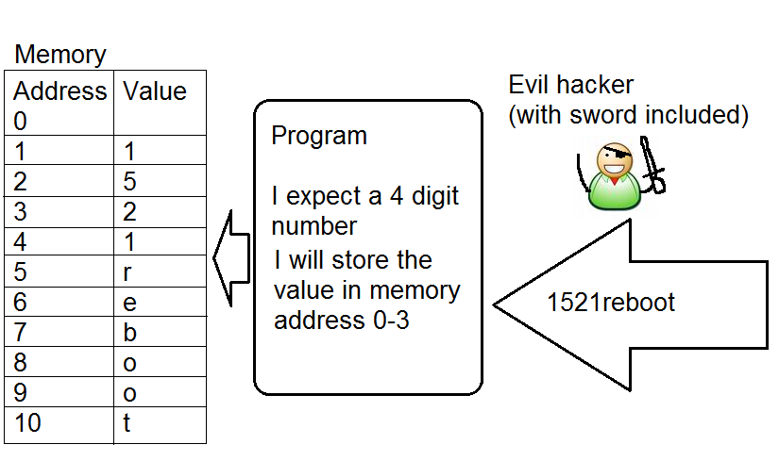
Buffer Overflow

Slide 14
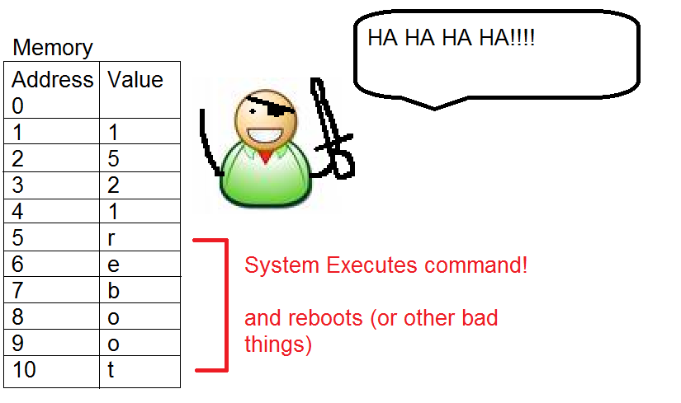
Buffer Overflow

Slide 15
Buffer Overflow
The previous example as shown was closer to command injection.
A real stack based buffer overflow would replace the reboot command with the machine code to make the system reboot, as well as over writing the return pointer on the stack with the address of the inserted machine code that would reboot the computer.

Slide 16
Buffer Overflows
Common buffer overflow types
  Stack based
  Heap based

Slide 17
Buffer Overflow
Best Defense against buffer Overflows
Educate software engineers with secure coding practices including input validation
Patching and making sure code is latest version (systems administrators)

Slide 18
Buffer Overflow
Buffer overflow defense unlikey to be seen on the exam.
Stack Canaries (compilers)
Non-executable stack and non-executable memory sections
  NX bit
  DEP
Address Space Layout Randomization (ASLR)

Slide 19

Smurf Attack

Slide 20
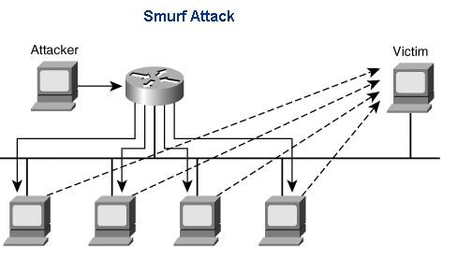
Smurf Attack (chapter 11 – 1031)

Slide 21
Smurf Attack
How would a smurf attack someone?
Find site to attack, say www.ebay.com
Forge Ping packet from www.ebay.com to a BROADCAST network address
Watch as the computers on the network all start pinging back www.ebay.com
Countermeasures
Drop forged packets at routers
Drop directed broadcasts at routers or end system
Use and IDS

Slide 22
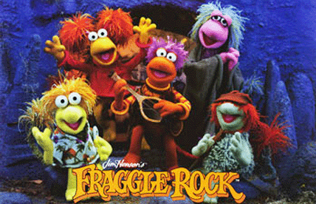
Fraggle

Slide 23
Fraggle (like Fraggle rock)
(chapter 11 – 1031)
Like Smurf, but uses UDP (echo and chargen)
Countermeasures
Drop forged packets at routers
Drop directed broadcasts at routers or end system
Disable echo and chargen services
Block echo and chargen ports on router
Use an IDS

Slide 24
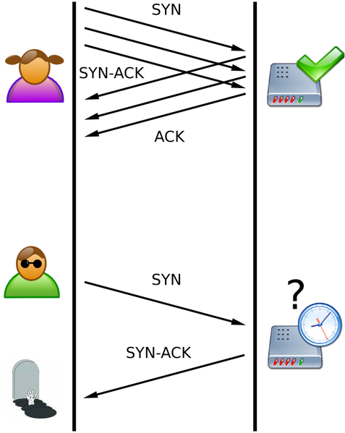
SYN Flood (chapter 11 – 1033)

Slide 25
SYN Flood
Attack
  Forge IP SYN packet from downed system
  Server responds to fake downed address, which never responds
  Use up all the listen queue slots
  Stops real new connections from establishing
Countermeasures
  Drop forged packets at routers
  Patch OS
  Decrease 3 way handshake timeout values
  Increase 3 way handshake max connections
  Use a firewall as a middleman

Slide 26
Ping of Death

Slide 27
Session Hijacking

Slide 28
Tear Drop
Overlapping fragments, cause OS to get confused and crash.
Countermeasures
Patch the OS
Drop fragments (problems?)
Use a firewall that does fragment re-assembly.

Slide 29
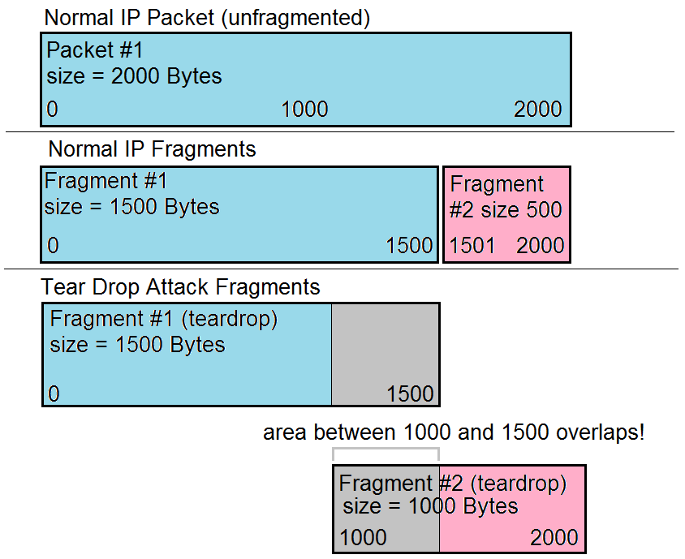
Tear Drop (chapter 11 – 1034)

Slide 30
LAND attack
Forging a SYN packet from a host to itself. Causing an loop of constant response to itself.

Slide 31
DDoS (chapter 11 – 1034)
Distributed Denial of Service – a brute force method that generally uses zombies or bots to build a botnet to overwhelm a target.
May consist of a hierarchy of Attacker, Masters and Slaves (see image 2 slides)

Slide 32
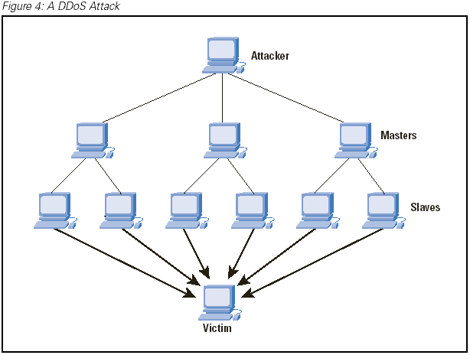
DDoS

Slide 33
DDoS
How are zombies and botnets usually created?

Slide 34
Maintenance Hooks (382)
(chapter 5)
A backdoor that software developers put into the code so they can easily access a system for the purpose of troubleshooting.
Countermeasures
  Code reviews by 3rd parties, if source code is available
  Use an IDS system to detect backdoors/maintenance hook usage
  Auditing (same as above)

Slide 35
Time of Check/Time of Use Attack (383)
A situation where the outcome of a command or processes are dependant on when certain steps are done.
Example.
Imagine I have $50.00 in an online gambling account. I say “bet all that’s in my account” on a football game tonight. After I place the bet I insert an additional $500.00 to my account. If for some reason that deposit gets in before the bet goes though, I might end up betting $550.00 when I only meant to bet $50.00

Slide 36
Time of Check/Time of Use Attack (383)
Countermeasures
  Do not split up critical tasks into pieces (make transactions atomic
  Lock out resource access to new operations while a current operation is running.
    Basic database concept of transactions
Race conditions are a time of ToC/ToU attack.

Slide 37
Root Kit (649)
What is a root kit?
What is the purpose of a root kit?

